Slide 1


Music Study Top 100 -- ETL Project
Ross Nicholson
Shreyashi Mukhopadhyay
Patrick pruckler
Hima devulapalli

Slide 2
Objective
Current popularity on Spotify of Top 100 greatest selling singles and artists of all-time.
Which genres/countries have:
-- Generated the highest sales
-- Are the most popular today

Slide 3
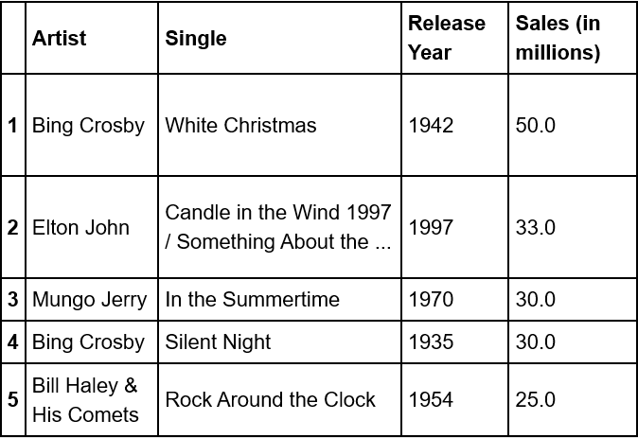
Extraction - CSV
We made a data frame of top 100 singles of all time, eliminating unwanted columns.

Slide 4
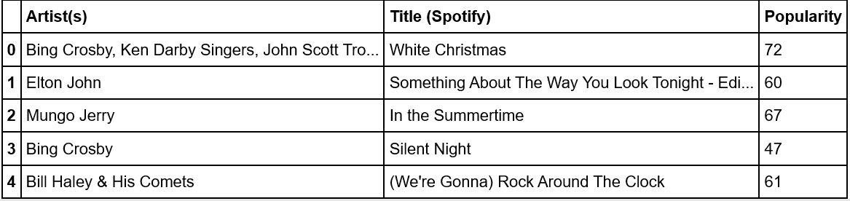
Extraction - Spotify API
Called Spotify API using “Spotipy” Python library
Looping through top 100 Singles csv, we extracted Spotify popularity.

Slide 5
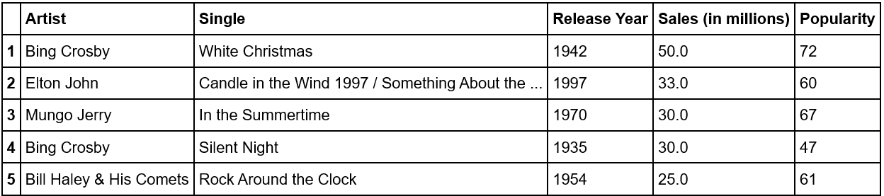
Transformation
We merged our top 100 data frame with the Spotify data frame.
Spotify Popularity is a 0-100 scale
based on frequency of streaming.

Slide 6
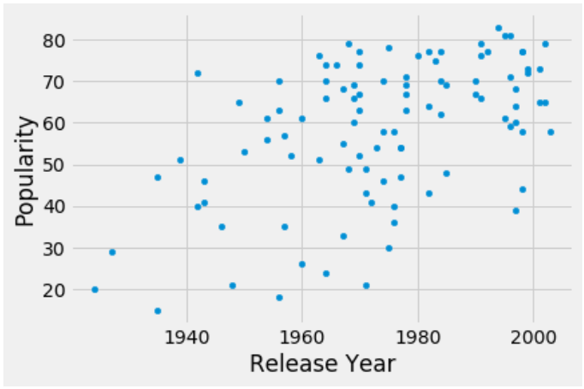
Popularity vs Release Year

Slide 7
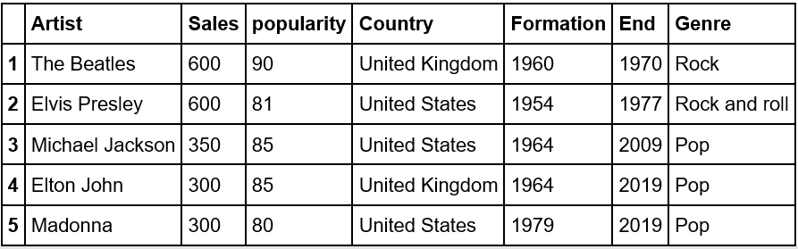
Top 100 Artists
Searching through Spotify API using our top 100 csv, we can then pull the top 100 artists of all-time, making another data frame.

Slide 8
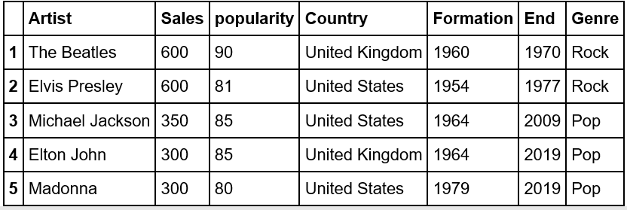
We cleaned the genre column (e.g. Rock and Roll → Rock), producing a new data frame

Slide 9
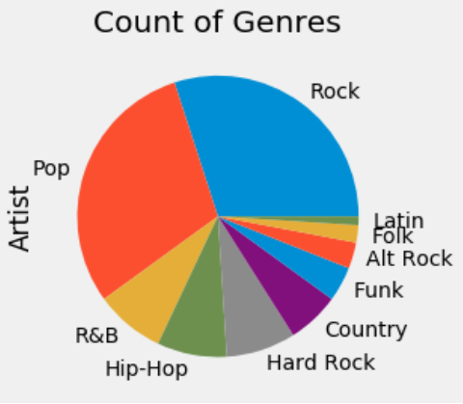
Count of Genre Pie Graph

Slide 10
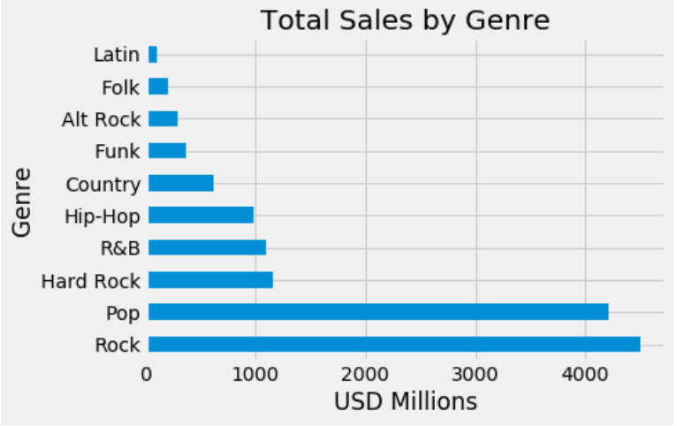
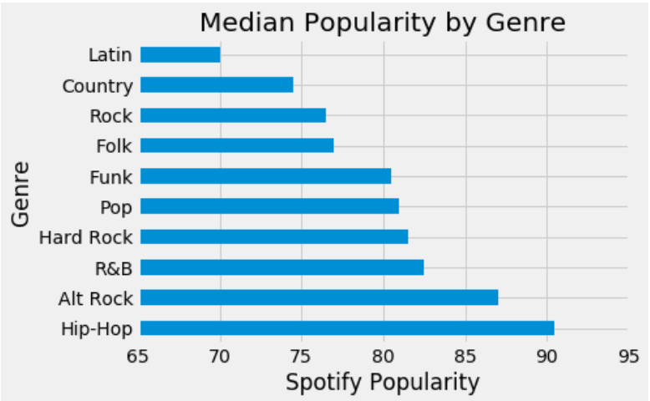
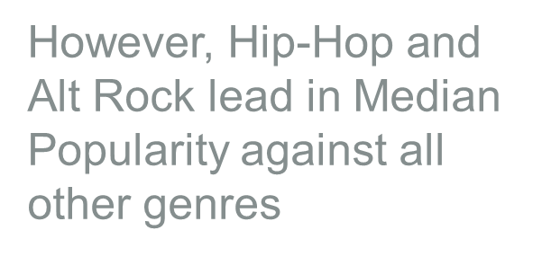
Sales / Popularity by Genre
Of the Top 100 artists, Rock and Pop have generated the most sales by far

Slide 11
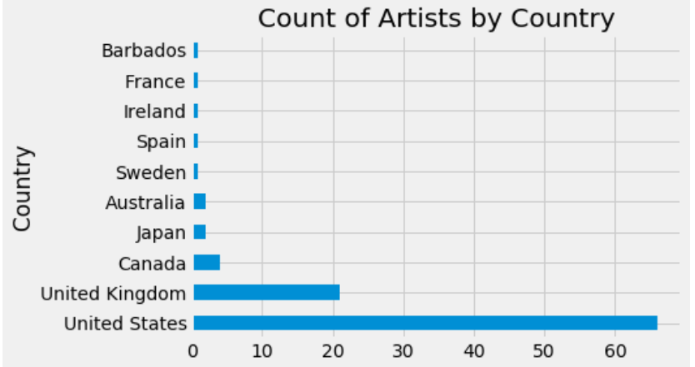
Count of Artists by Country
United States and United Kingdom dominate the Country count of Top 100 Artists

Slide 12
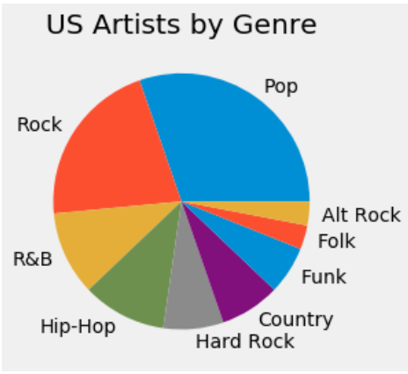
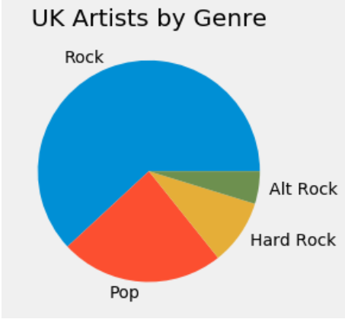
Comparison Pie charts
Comparing genres, the US representation is far more diverse than that of the UK (all Rock and Pop).

Slide 13
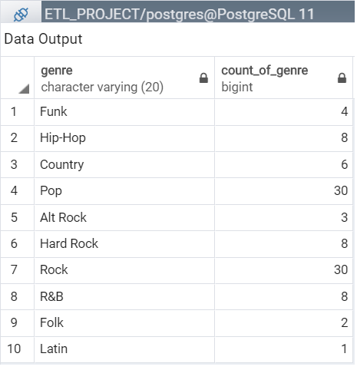
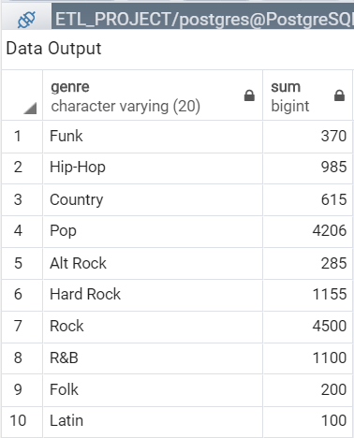
LOAD - POSTGRES TABLES
Genre Count
Genre Sales

Slide 14
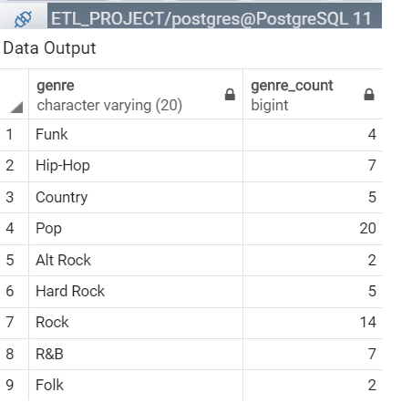
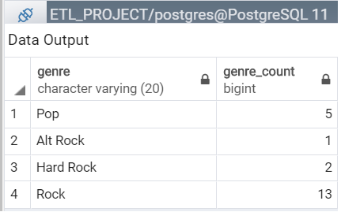
LOAD - POSTGRES TABLES
US Genre Count
UK Genre Count

Slide 15
Summary
1. Of the Top 100 Selling Singles of all-time, those released more recently had higher Spotify Popularity.
2. While Rock / Pop artists Top 100 artists have generated the more all-time album sales, Hip-Hop and Alt Rock are currently more popular on Spotify.
3. Most Top 100 Artists are from the US / UK, with the US representing a far wider spread of genres.

Slide 16
Thank you!

